Slide 1
Module : OP&E Tools
Assortment Management
Notes:
Good Morning/ Afternoon
Today my main objective is to keep you” awake and interested” in understanding the overall technical foundation.
Feel free to ask any questions you may have; we will answer immediately or at the end of the chapter.
A little logistic reminder > please switch off your portables. Thanks

Slide 2
Sign-off Control Section
Name | First Name | Function | Document Version | Date | Signature
Le Maout | Robert | TME University lead | Final
Witt | Matthew | Laptop Deployment lead | Final

Slide 3
Objectives of this module
After this module, you will be able to
  Understand how the TME applications support the BP processes for Assortment Management
  Create Clusters in Siebel Marketing and use them in Siebel Sales CG
  Create generic and specific Assortment Propositions in Siebel Sales CG
  Review Assortment data in Siebel Analytics
Notes:
Review key objectives as documented on the slide with your participants.

Slide 4
Table of contents
Introduction to Better Practices for Assortment Management
  Definition
  Process Overview
  Capability Interdependencies
Tool support for Assortment Management processes
  JTI versus Siebel Terms
  Tool support
  Tool step overview by BP process
  Tool steps in detail
Demo & Exercises
  Tool demo
  Exercises

Slide 5
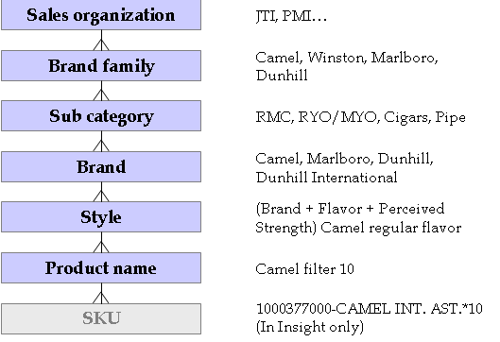
Introduction
Assortment Management - Definition
Assortment Management:
  Assortment Management is the process of determining the product assortment (sometimes referred to as ‘range’) required to maximize the financial and commercial value either for the whole Tobacco category (sophisticated Accounts) or only for JTI Brands (all the other Accounts).

Slide 6
Introduction
Assortment Management – Process Overview
Process Overview
Process Description
Review& analyze input from ASP and competitor insight
Understand the role that the whole Tobacco category or the JTI assortment has to play in the Channel / Segment by reviewing and analyzing the ASP and competitor positioning.
E1
E1
Yearly
Develop assortm.
proposition by Channel / Segment /Cluster
Determine the depth and the weight of the sub-categories / Product Segments in each Channel / Segment / Cluster.
E2
E2
Customize ass. proposition by Account / Outlet
Customize the generic assortment proposition - taking consumer characteristics / preferences, the role of the Tobacco category and Account / Outlet characteristics into account. (Only for Strategic Accounts / Outlets)
E3
E3
Ad Hoc
Ensure execution at POP / POC
Communicate the assortment agreement and implementation plan and execute at POP / POC
E4
E4
Measure /Evaluate Assortment Management
Measure the assortment compliance against assortment agreement and implementation plan. Measure assortment effectiveness and evaluate impact on replenishment systems. Issue evaluation report.
E5
Quarterly
E5

Slide 7




Introduction
Assortment Management – Interdependencies
Assortment Management concerns 3 TME roles:
  The Category Developer
  The Trade Marketer
  The Operational Planner
Brand Mgmt
Channel/Segment Mgmt
Key Account Mgmt
→ Strategies, Objectives and Guidelines
Category Developer
Operational Planner
Trade Marketer
Responsible for
Reviewing historical data in Siebel Analytics
Planning, creating and targeting new Assortment Propositions in Siebel Sales
Measuring Assortment Proposition effectiveness
Responsible for
Preparing the work plan for the Trade Marketers using Siebel Sales CG
Analyzing the TM effectiveness in Siebel Analytics
Responsible for
Ensuring compliance of the Assortment Proposition at the POC/POP
Providing input in Siebel Sales CG during Outlet visits
Notes:
Verify the caller’s contact and address information by opening the Account Address multi-value group (MVG). If the appropriate address does not exist, you can create a new one by clicking the New button on the MVG and entering the information.

Slide 8
Introduction
Assortment Management – Interdependencies
Trade
Marketers
Brand
Channel & Segment
Account Mgmt
Agreements
Retail audits
Review & analyze
input from ASP &
competitor Insight
Guidelines
Visit Reporting
1
Objectives
Strategies
Channel/Segment
Program Guidelines
Siebel Analytics
Category Developer
Measure & Evaluate efficiency & effectiveness
5
2
Siebel Analytics
Develop Assortment Plan
Catalogs
Planning Groups
(Target Clusters)
Season validity
Plan visits & activities
Assortment
Management
Siebel
Sales
Ensure execution
at POP / POC
4
3
Customize Assortment Plan by Account
(only for strategic Accounts / Outlets)
Detail & Assign
Assortment activities
Operational
Planner
Siebel
Sales

Slide 9
Table of contents
Introduction to Better Practices for Assortment Management
  Definition
  Process Overview
  Capability Interdependencies
Tool support for Assortment Management processes
  JTI versus Siebel Terms
  Tool support
  Tool step overview by BP process
  Tool steps in detail
Demo & Exercises
  Tool demo
  Exercises

Slide 10
Tool support for Assortment Management
JTI versus Siebel Terms
JTI term
Siebel term:
Product Product
Product segmentation Product Catalog & Categories
Period Season
Segments, Clusters Planning Groups
Outlets Accounts
Accounts Accounts
Assortment Proposition Assortment Plan
Retail audit Retail Audit (Actual Assortment)

Slide 11
Tool support for Assortment Management
JTI versus Siebel Terms
Products
Product entity is used to create and store the products distributed by JTI and its competitors.
Local market administrators are responsible of creating and maintaining products.
Product Segmentation (Catalogs & Categories)
The product segmentation is used to classify the products. In Siebel terms, the product segmentation is called the Product Catalog, and the various levels are Categories. Siebel supports as many levels as required by business’s needs.
  Creating and maintaining the product segmentations and levels are administration tasks to be performed by local administrators.
The “standard” JTI way to use Siebel catalog and categories will be to create a catalog with 3 levels (Sub-category → Product segment → SKU).
Local market administrators are responsible for
creating and maintaining products & catalogs

Slide 12
Tool support for Assortment Management
JTI versus Siebel Terms
Outlets (Accounts):
Accounts are used to represent the companies and outlets to which products are sold. Two levels of accounts are implemented:
  Key account/Account: name of the company to which the points of distribution belong.
  Outlet: One specific point of distribution.
Account views are used:
  To create, visualize and update accounts,
  To set up and maintain account hierarchy,
  To define and maintain account detailed profile information.
Each account is associated to 1 or many assortment plans:
Trade Segmentation: Segments & Clusters (Planning Groups)
Planning Groups are the Siebel term for list of outlets within in the JTI terminology.
Planning Groups allow the assortment manager to create the same assortment proposition for a number of outlets with similar planning needs.

Slide 13
Tool support for Assortment Management
JTI versus Siebel Terms
Assortment Proposition (Assortment Plan)
Assortment plans contain detailed information about products that JTI plans to make available on the market in an upcoming period of time.
Assortment plans are created and maintained by the assortment manager (Category Developer).
Assortment plans are created for
  Outlets/Accounts: (via Planning Groups)
  Merchandising Locations
Assortment plans can be :
  Generic plans: the plan is always relevant and repeated through several periods of time.
  Temporary deviation plans: the plan is specific to a season and/or event.

Slide 14
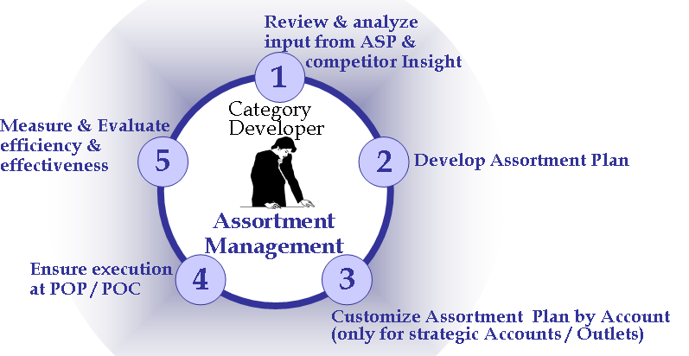

E.1. Review and Analyze
Tool support
The Category Developer can review and analyze
historical data from the Dashboards in Analytics
Input:
From who What
Tool
support
ASP
Competitor Reports
Guidelines
Process
action
Siebel
Sales
Category
Developer analyzes macro and micro trends & objectives
via File Upload
Brand Marketing
Channel / Segment /
Account Mgmt
Assortment Compliance Data
Sales : “Literature” screen
Analytics: Assortment Dashboards
via Siebel Sales CG
Assortment Dashboards
Trade Marketers

Slide 15
E.1. Review and Analyze
Tool support
Siebel Analytics supports the Assortment
capability by 3 global dashboards
The first BP process E.1 is supported by the “Review Input” dashboard
Assortment Management
Review Input
Execute in PoP/PoC
Evaluate Assortment
Performance by Product
Consumer Profile
Assortment Performance
Key performance Indicators
Competitive Performance

Slide 16
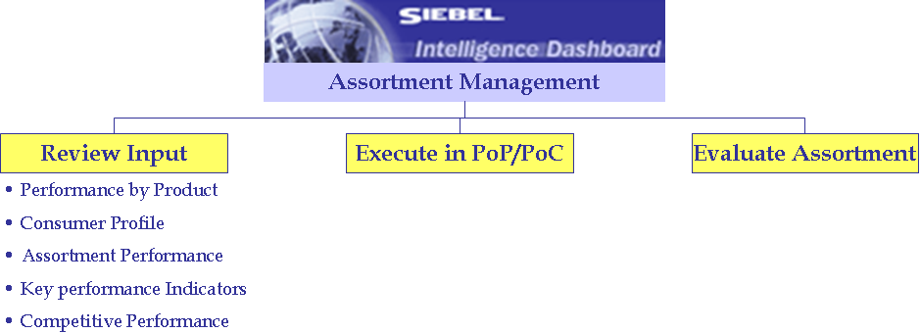
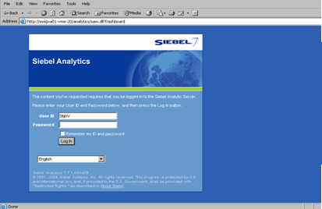
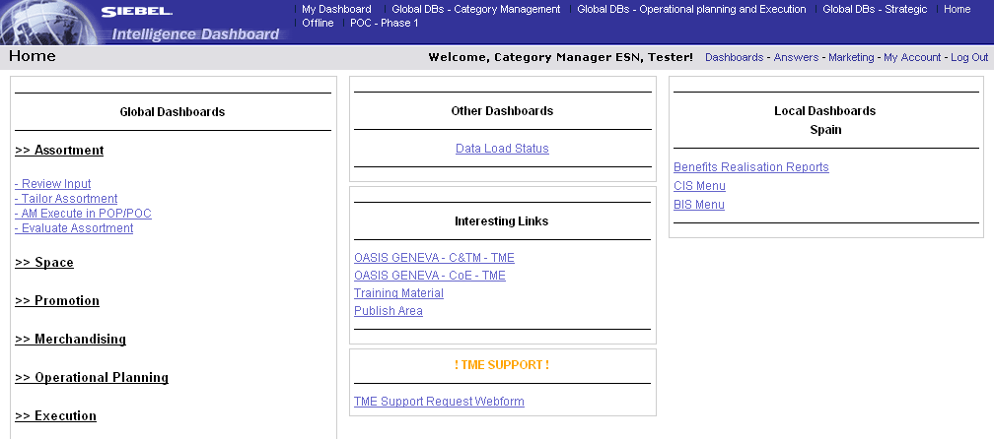
E.1. Review and Analyze
Dashboard – Review Input
Analytics Dashboards for Assortment
1
3
2
4
Navigate in Siebel Analytics
In an Internet Browser, enter the URL of the Siebel Analytics application
In the Login Page, enter
  User ID
  Password
  Language
The Home Page opens
Navigate to the dashboard
  Click on the “Assortment” link
  Click on the “Review Input” link

Slide 17
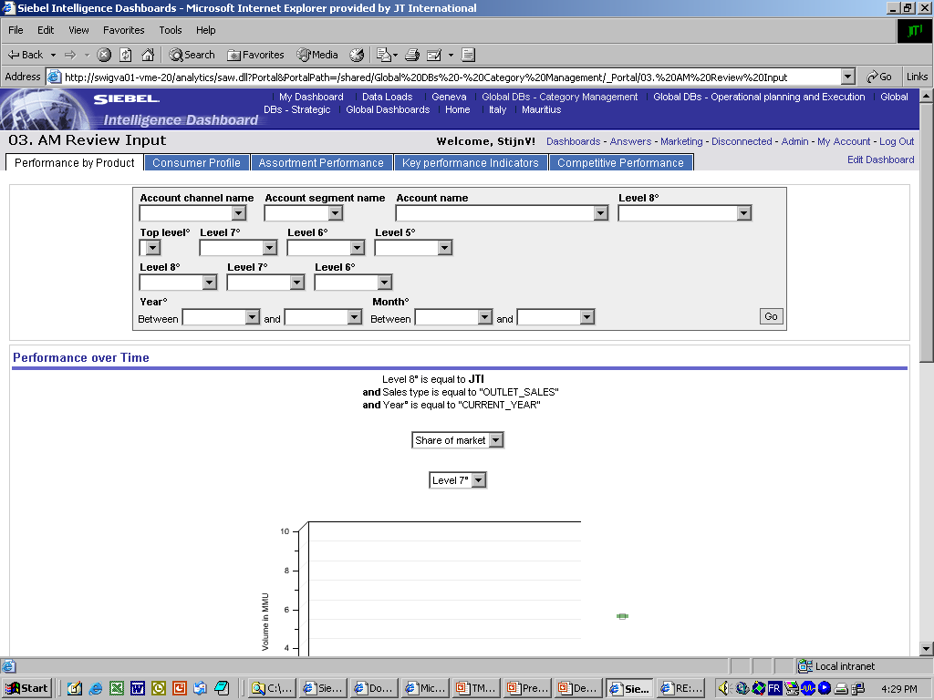
E.1. Review and Analyze
Dashboard page – Performance by Product
Performance by Product
  Analyze the performance evolution in time for
  products (from category till product level) for
  an account versus its channel and the market.
Analytics menu
Sub-menu
Dashboard pages
1
Search variables
„Filters“
2
3
Results
displayed as:
Graphs
Tables
Analyze product trends for a specific account/area versus market averages
Select values for the query
Define the period
Click GO

Slide 18
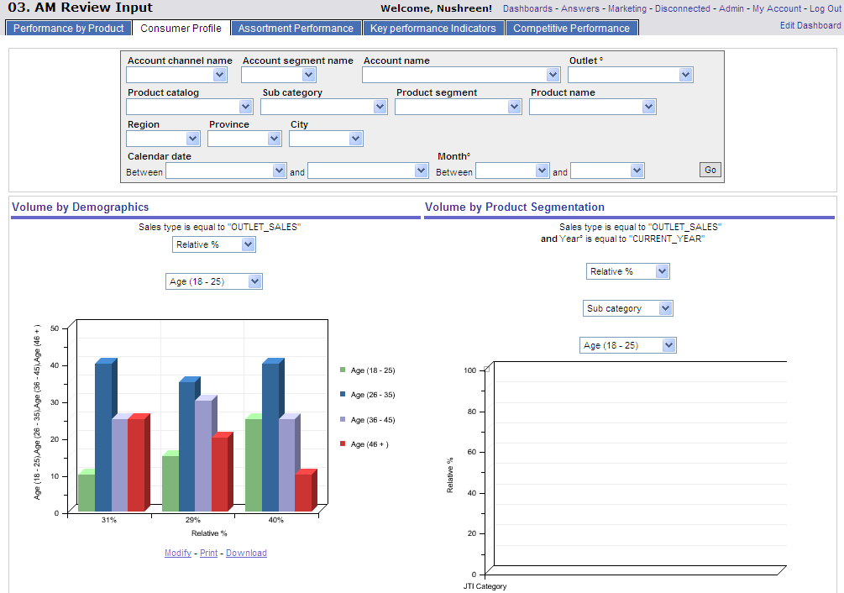
E.1. Review and Analyze
Dashboard page – Consumer Profile
Consumer Profile
  Analyze which consumers consume which
  product within a certain area or for a
  specific channel, segment or account
1
2
3
Review local consumer preferences
Select values for the query
Define the period
Click GO

Slide 19
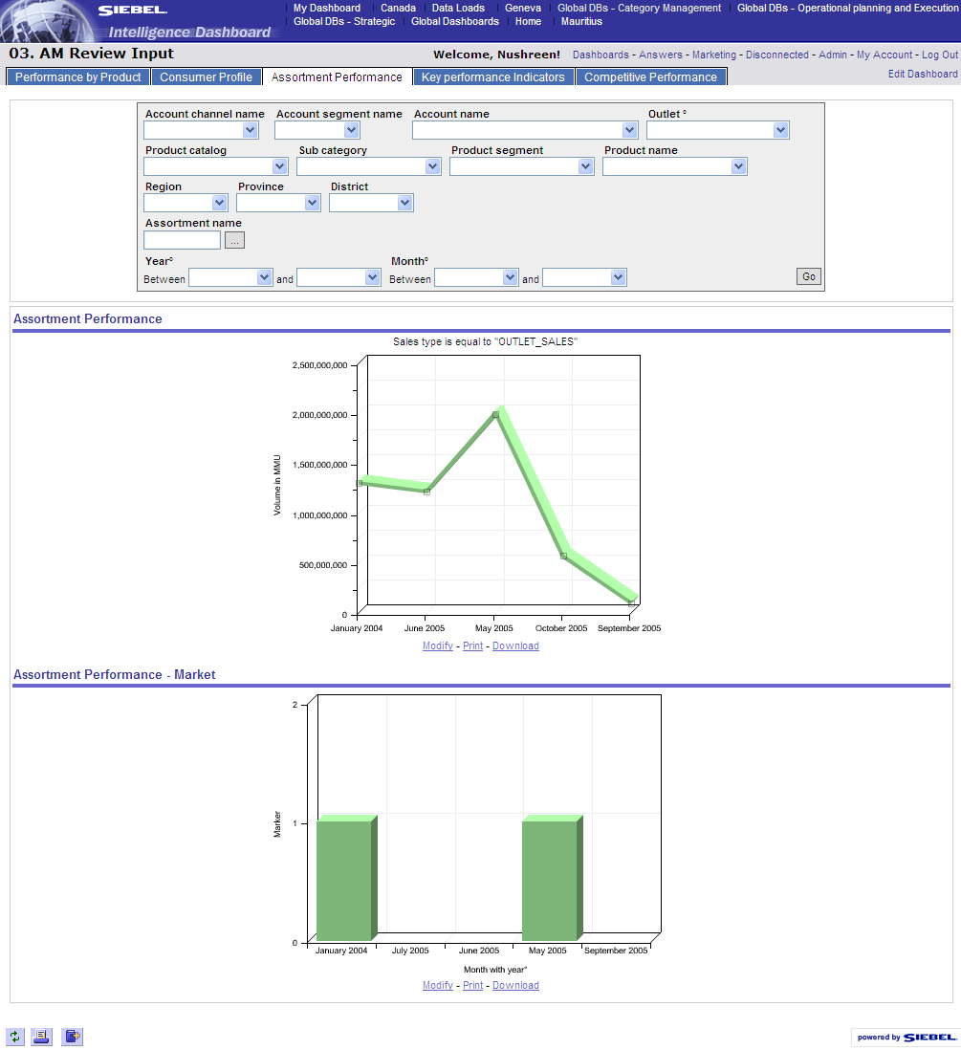
E.1. Review and Analyze
Dashboard page – Assortment Performance
Assortment Performance
  Review the sales trends for an assortment for a
  specific channel, segment, account, region
  versus the market average
1
2
3
Reports for the “Assortment Performance” Dashboard Page
Select values for the query
Define the period
Click GO

Slide 20
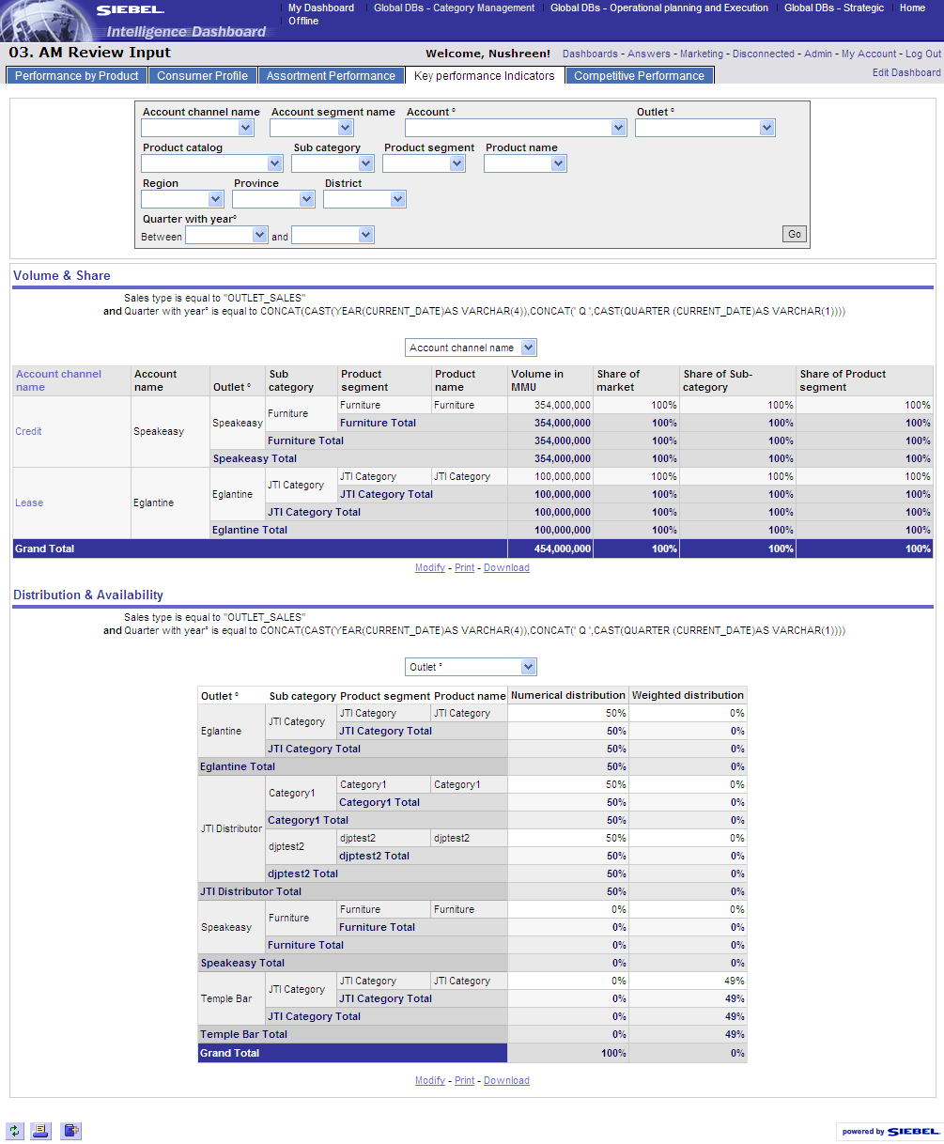
E.1. Review and Analyze
Dashboard page – Key Performance Indicators
Key Performance Indicators
  Review channel, segment, account KPIs such
  as volume, SoM and weighted distribution
1
2
3
Reports for the “Key Performance Indicators” Dashboard Page
Select values for the query
Define the period
Click GO

Slide 21
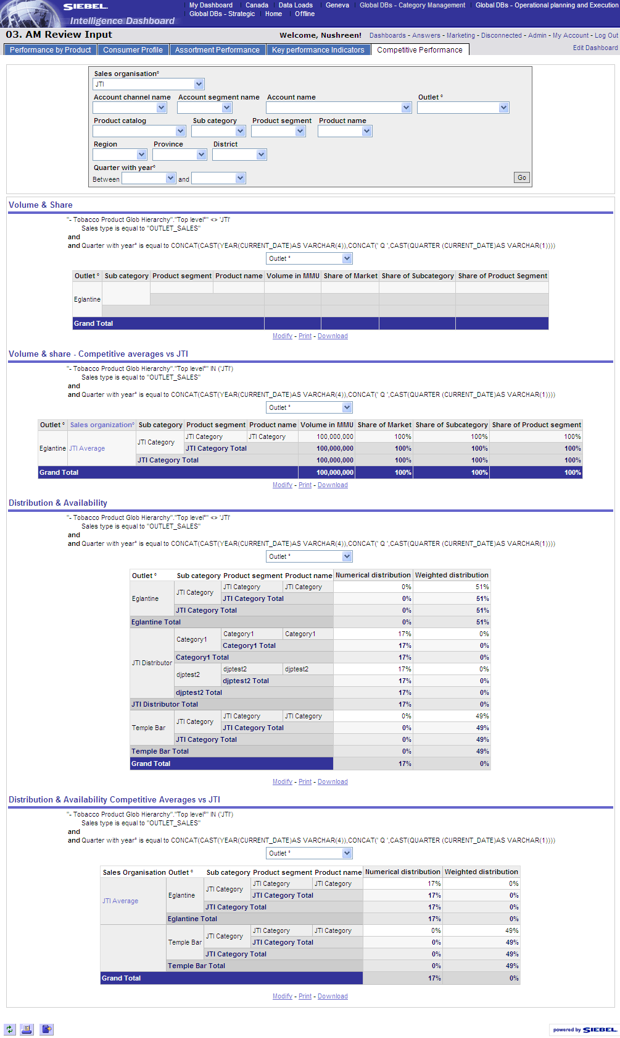
E.1. Review and Analyze
Dashboard page – Competitive Performance
Competitive Performance
  Compare the KPIs for JTI products versus
  competitive products for channel, account, …
1
2
3
Reports for the “Competitive Performance” Dashboard Page
Select values for the query
Define the period
Click GO

Slide 22

E.2. Develop assortment proposition
Tool steps
The Category Developer builds the generic
assortment proposition using both Siebel Sales
and Siebel Marketing (clusters)
Create a cluster of outlets
Marketing
Create a List and import Accounts
Create a planning group
Apply Target List in the Planning Group, and Commit selected outlets
Sales
Create a catalog and define categories
Create an assortment plan
Define the Product Catalog *
Link the Planning Group to the assortment
Define the validity period *
Define the Assortment mix
Review the Products within the Assortment
Attach Assortment Guidelines
Develop child assortments for secondary locations
Communicate the Assortment to all accounts
Check deployment
* Seasons and products are created by the local administrator

Slide 23
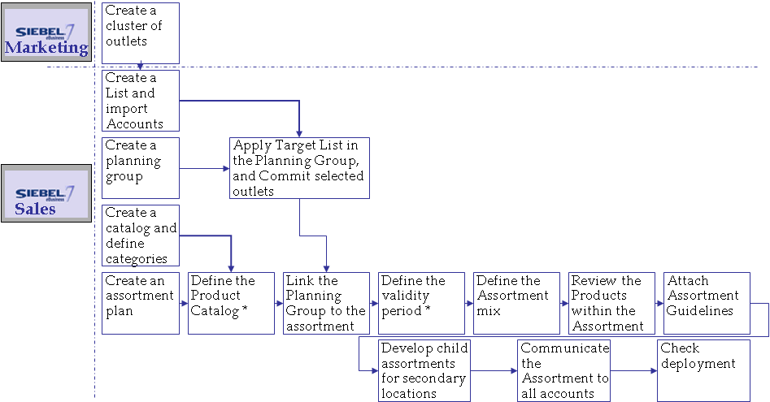
E.2. Develop assortment proposition
Different ways to target a group of accounts
Defining the cluster of accounts applicable to the
new assortment plan is a task for the Category
Developer with support of the Operational Planner
Various options are possible for targeting outlets for
an assortment plan
  For a channel/segment
    SSCG*: Planning Group: Select an “Account type” or “Segment”
    Advised is to save the selected accounts as target list and then apply to the planning group (easy for later use such as updates on assortment plan)
  For outlets belonging to one parent account (Key Account)
    SSCG: Planning Group: Select a “Parent Account” (e.g. Shell)
    Advised is to save the selected accounts as target list and then apply to the planning group (easy for later use such as updates on assortment plan)
  For a cluster
    Siebel Marketing: create more complicated clusters based on queries and the combination of one or more data sources (Consumer data, survey data, etc.)
    SSCG : load the cluster as Target List, then apply Target List within the Planning Group
  For one account (Strategic Account) → Select one account
* Siebel Sales Consumer Goods

Slide 24
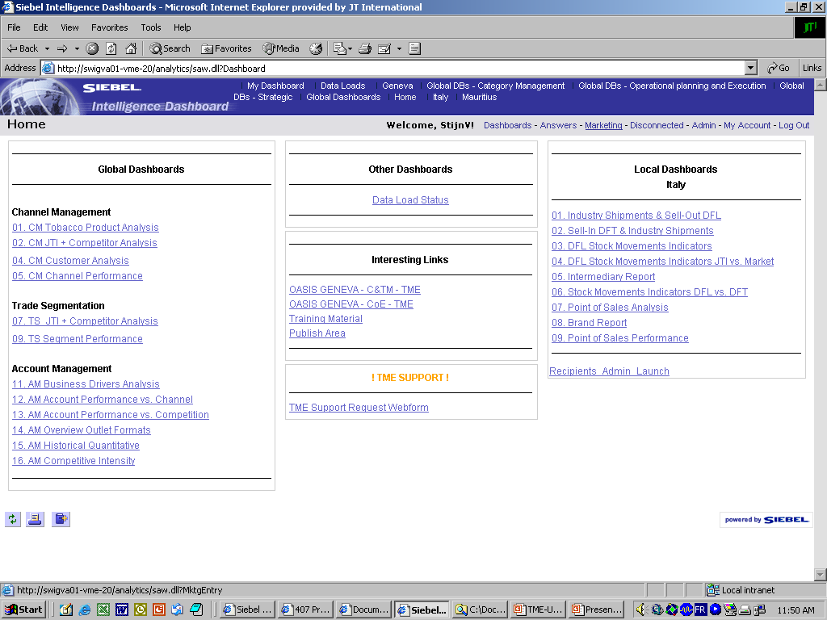
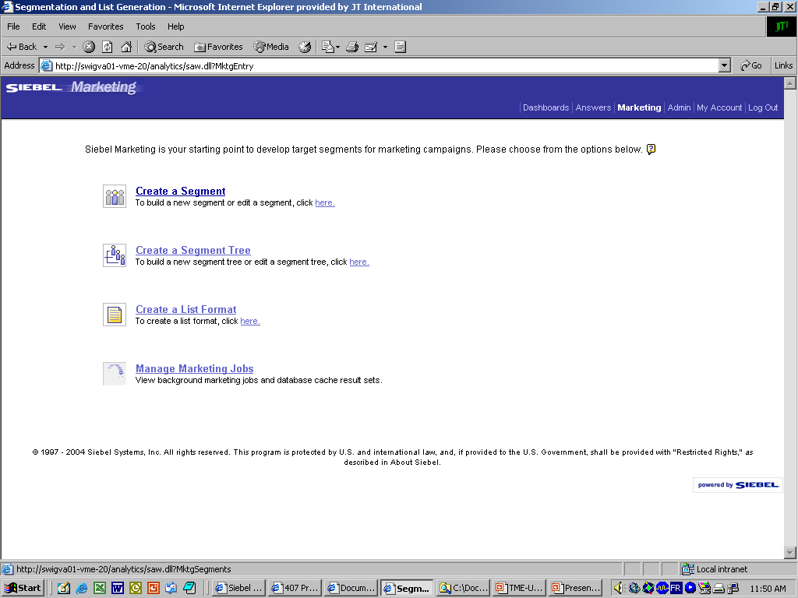
E.2. Develop assortment proposition
Create a cluster
Pre-requisite: Create a cluster (1/3)
1a
1b
2
Navigate to Siebel Marketing Analytics
  Login into Siebel Analytics (Insight)
  Click on ‘Marketing’ in the Menu bar
Click Create a Segment

Slide 25
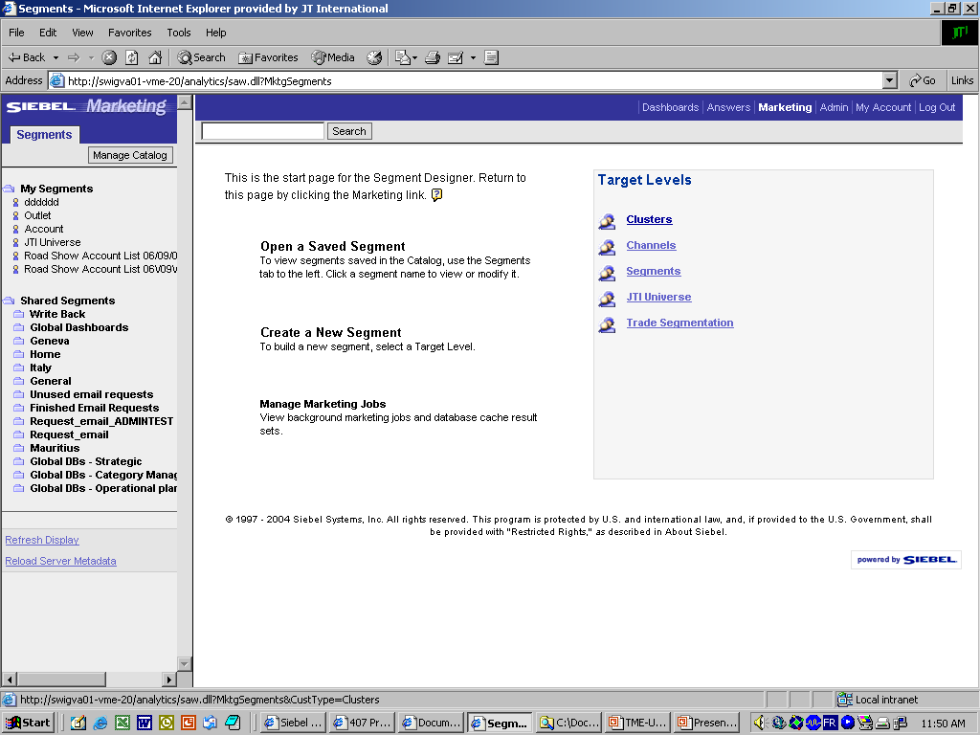
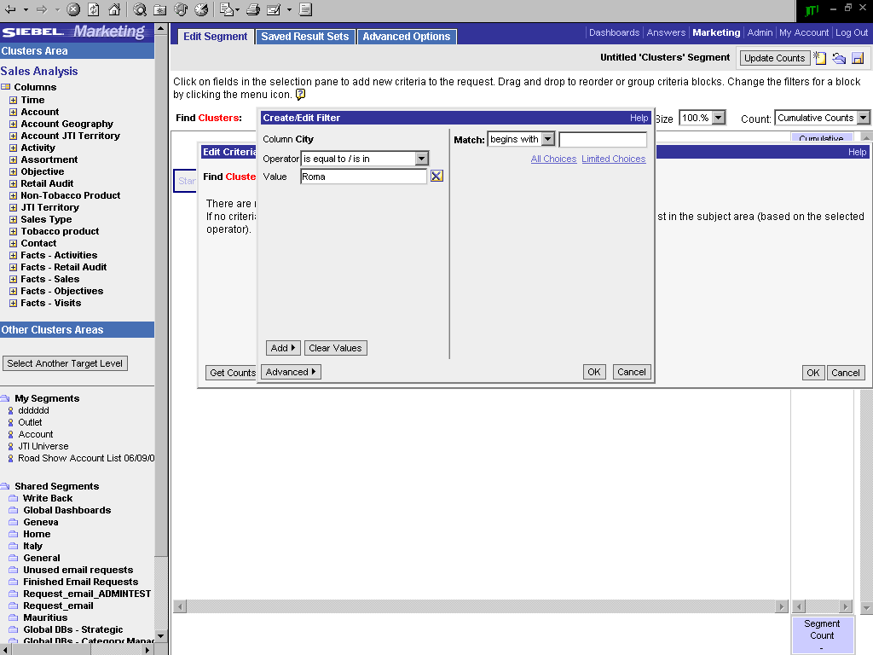
E.2. Develop assortment proposition
Create a cluster
Pre-requisite: Create a cluster (2/3)
1
2a
2b
2c
2d
Clusters created by the user
Select the cluster level to be created
To create a new cluster, define the variables:
  Choose among variables
  For each variable, define search method: Operator
  And enter value
  Click OK
Shared clusters

Slide 26
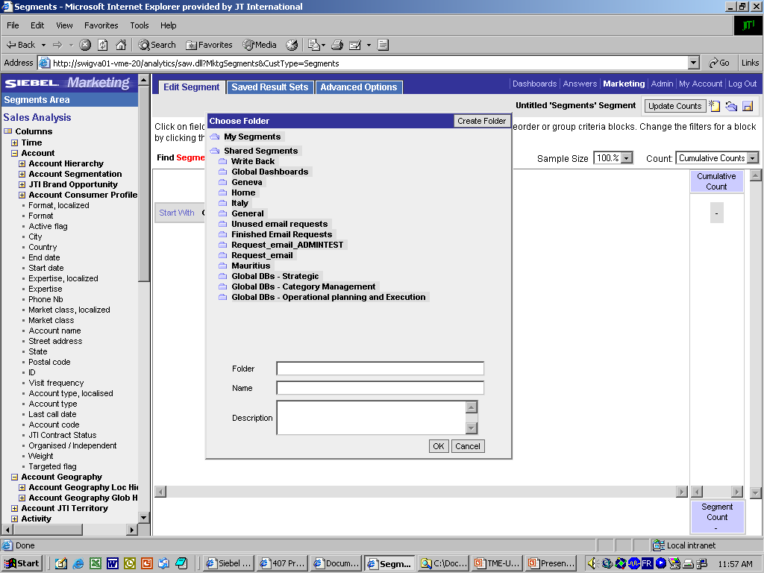
E.2. Develop assortment proposition
Create a cluster
Pre-requisite: Create a cluster (3/3)
  Save the created cluster
1
2
2a
Click the Save icon
Save:
  Select a folder where you want to save the Cluster
  BE AWARE! The value shown in the field “Folder” is equal to the value you will have to add later in the field “Analytics Path” when importing the cluster within a Target List in Siebel Sales
  Enter name for the cluster
  BE AWARE! The value shown in the field “Name” is equal to the value you will have to add later in the field “Segment Name” when importing the cluster within a Target List in Siebel Sales
2b

Slide 27
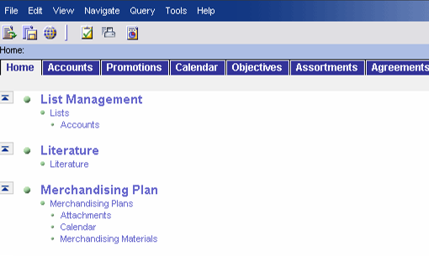
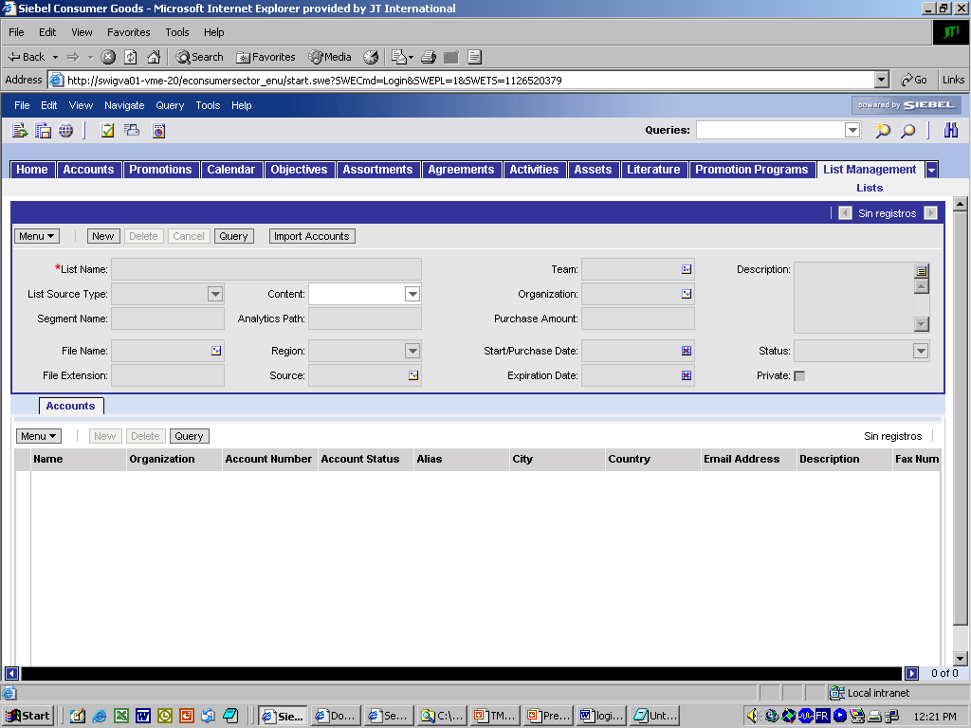
E.2. Develop assortment proposition
Create a target list for the cluster
Pre-requisite: Import the cluster in Siebel Sales
  Within Sales you create a Target List and load all
  the accounts from the cluster within („Import“)
1
2a
2b
Log into Siebel Sales CG
Navigate to the List Management functionality
  Go to the site Map
  Go to the List Management/ Lists/Accounts view
Create a new list that will contain the cluster
  Click New
  Enter List Name
  Choose value ‘Targeted List’ in the List source type drop-down menu
  Enter the Analytics Path for Siebel to import the correct values (The “Folder”)
  Enter exact name of the Segment created in Analytics
Click ‘Import Accounts’
The accounts are listed in the bottom list-applet
3a
4
3b
3c
3e
3d
5

Slide 28
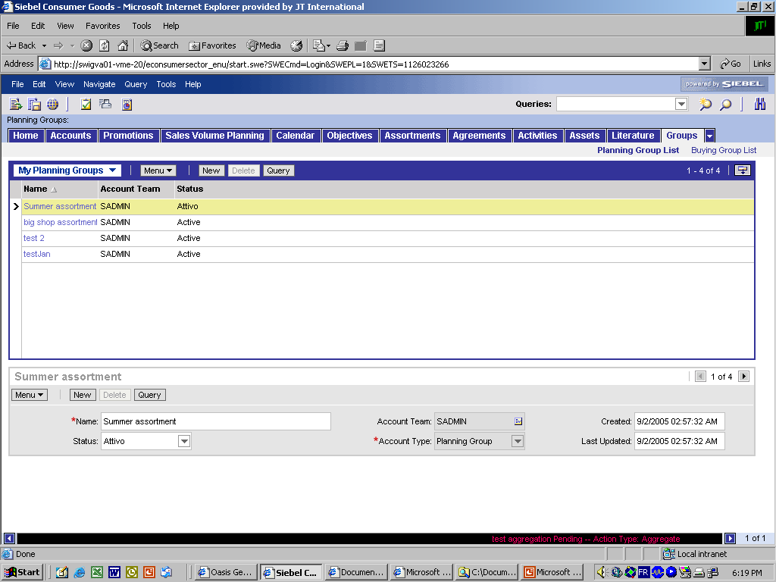
E.2. Develop assortment proposition
Create a planning group
In Siebel Sales, create a Planning Group (1/2)
  A Planning Group is necessary for Assortments.
  It is a container of accounts to be linked and
  applied to an assortment.
1
4
☺
Create a new Planning Group
Go to screen “Groups”
Click “New” button in form applet below
Fill in the mandatory fields
  Fill in name of new Planning Group in the field “Name”
Drilldown in the record by clicking in the Planning Group Name in the list-applet
2
3a

Slide 29
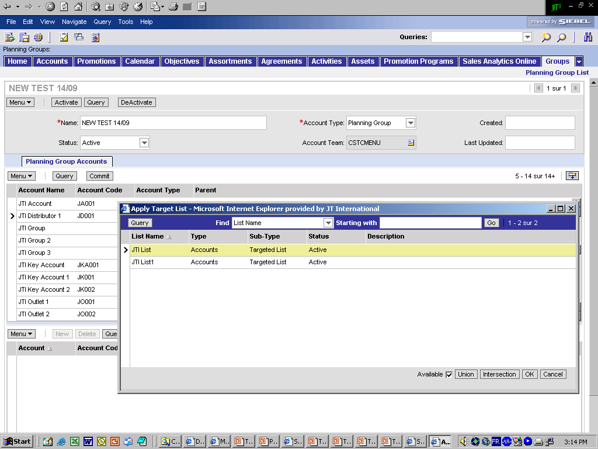
E.2. Develop assortment proposition
Apply the cluster to the planning group
In Siebel Sales, create a Planning Group (2/2)
  Apply Target List in the Planning Group,
  and Commit selected outlets
2a
Detail-applet of the record
Add accounts in the Planning Group
The initial list displays all available accounts in the JTI Universe.
The objective is to obtain only the correct accounts in the list.
Picking a Target List will overwrite the current list with a reduced list with only the correct accounts
  Click on the Target List icon.
  In the pick-applet window, select the List and click OK
The middle list-applet of accounts is replaced by only the accounts contained in the Target List
Select all accounts (Ctrl+A)
Click the ‘Commit’ button
The accounts are now added in the bottom list, and applied to the Planning Group
5
List-applet of accounts
2b
1
3+4
List-applet of accounts
applied to the planning group
6

Slide 30
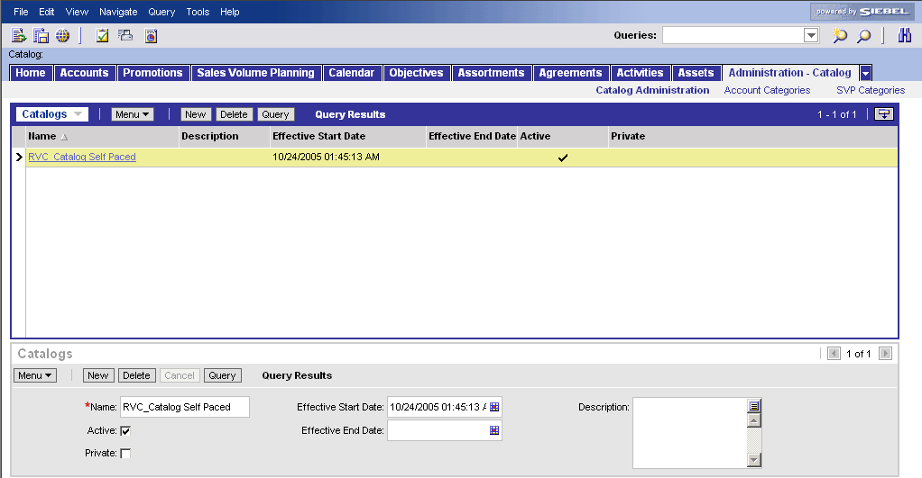
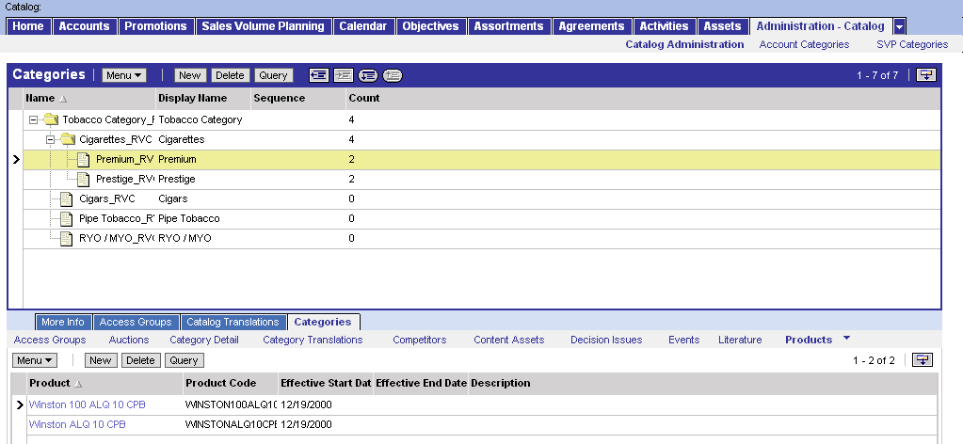
E.2. Develop assortment proposition
Create a catalog
Create a new Catalog and define categories
1a
1b
2a
2b
2c
3a
☺
3c
Create a new catalog
Navigate to the Catalog Administration view
  Go to SiteMap and click on the “Administration – Catalog” link, following on the “Catalog Administration” link
  The view “Catalog Administration” opens
Create a new Catalog
  Click on the “New” button
  Add a new name (be clear and consistent!)
  Indicate the Start and End date (impacts “Active” field)
Define categories and its hierarchy
  Drill down on the new Catalog and open “Categories” view
  Click new button and name the categories
  (Product category, sub-category and product segment)
  Indicate level in hierarchy by clicking on the buttons
Add products to the categories (in the Products applet)
  Indicate the category by selecting(mouseclick on record)
  Click on New button and pick products in pick applet
3b
4a
4b

Slide 31
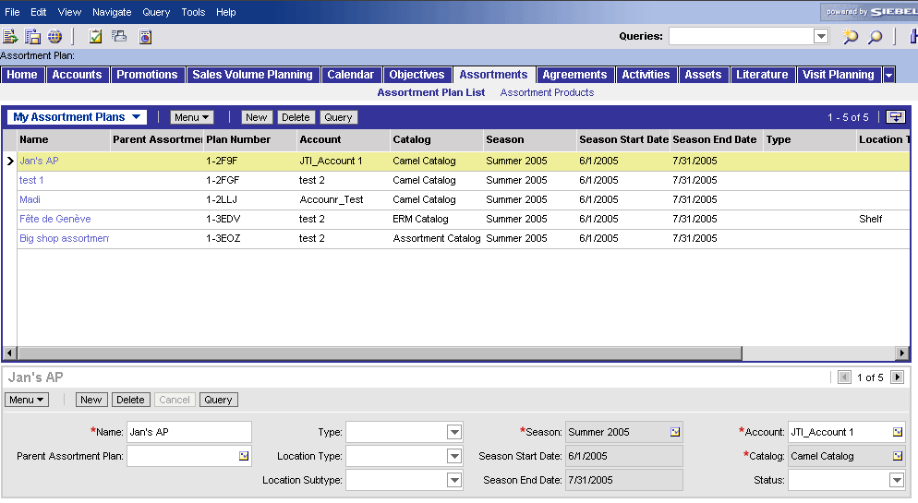
E.2. Develop assortment proposition
Create an assortment plan
Create a new Assortment Plan
Go to screen “Assortments”
Click “New” button in form applet below
Fill in the mandatory fields
  Fill in name of new Assortment in the field “Name”
  Enter Assortment Type to highlight that it concerns a generic, a strategic account specific or a seasonal deviation assortment proposition
1
List-applet of all existing Assortment Plans for which the Cat. Developer has the visibility
2
Detail-applet of the record
3a
3b

Slide 32
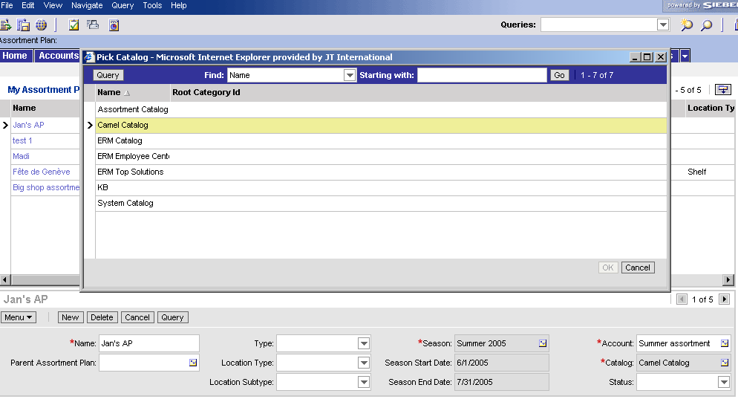
E.2. Develop assortment proposition
Select the catalog
Select the Product Catalog
  Link the product Catalog to the assortment plan
1b
1c
Fill in the mandatory fields: Select a Product Catalog
  Click on the Pick-applet icon
  The pick-applet window displays the list of all Catalogs created by the Local Administrator
  Select the record
  Click OK
1d
1a

Slide 33
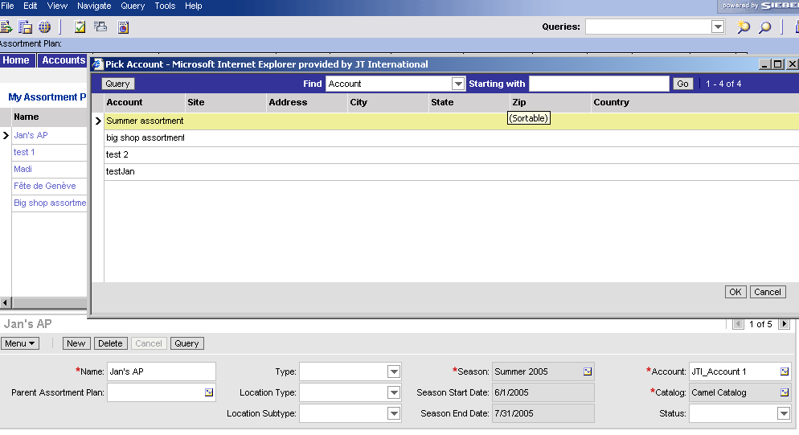
E.2. Develop assortment proposition
Select the planning group
Link the Planning Group to the assortment by
selecting the field Account (shows all accounts +
all planning groups)
1b
1c
Fill in the mandatory fields: Select an Account
  Click on the Pick-applet icon
  The pick-applet window displays the list of all Accounts and all Planning Groups
  Select the record
  Click OK
1d
1a

Slide 34
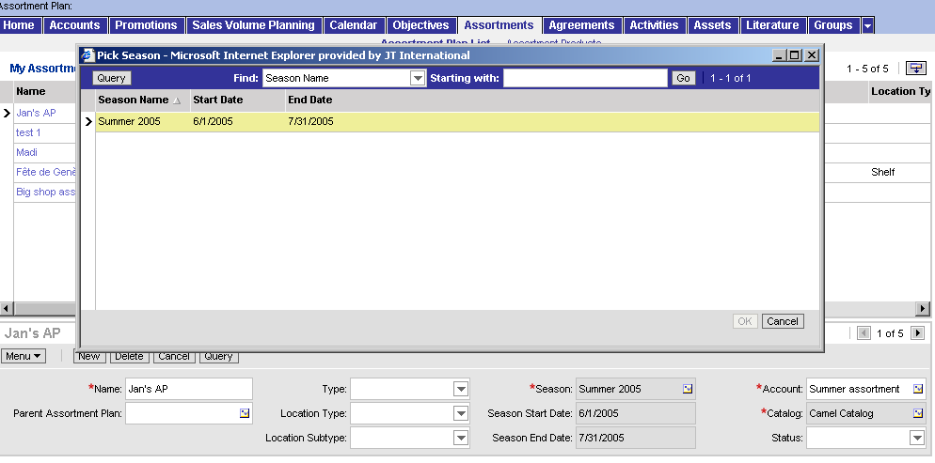
E.2. Develop assortment proposition
Define the active period for the assortment
Define the validity period of the Assortment , i.e. the
season. This is different from “Period”
  A period: a structured period of time within a hierarchy
  (e.g. Year, Quarter, Month …) e.g. used for Promotions, Objectives, …
  A season: does not follow a hierarchy and can be spread over several periods
  (e.g. Summer or Winter 2005) and is typically used for Assortment Plans.
1b
1c
2
☺
Fill in the mandatory fields: Select a Season
  Click on the Pick-applet icon
  The pick-applet window displays the list of all Seasons created by the Local Admin
  Select the record
  Click OK
Drilldown in the Record
Local market administrators are responsible for
creating and maintaining seasons
1d
1a

Slide 35
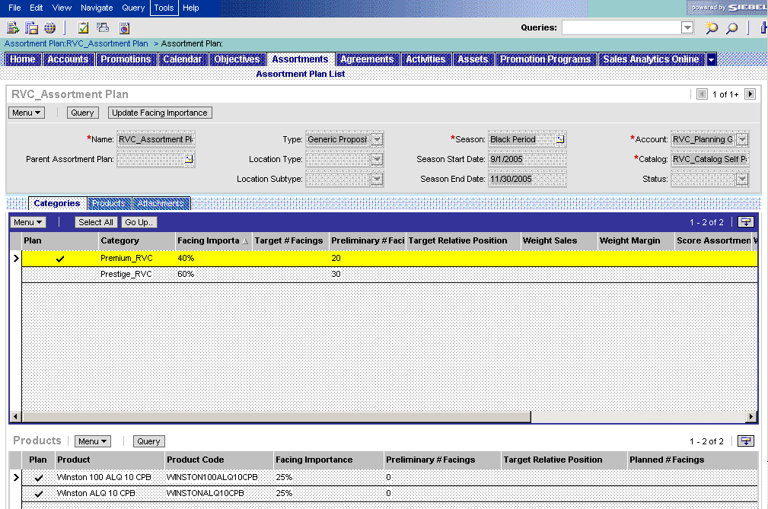
E.2. Develop assortment proposition
Define the assortment mix
Define the assortment mix of products
  For each product level, flag (field ‘Plan’) categories
  that should be included in the Assortment and
  enter corresponding facing importance
Detail-applet of the record
Define which categories & products to include and which facing importance they should have
Navigate to the Categories view
For each Category
  check the flag of Categories that need to be included in the Assortment Proposition
  Enter corresponding Facing Importance
  (needs to total 100% for each level)
  Drilldown to the next Category Level
For each product (only on lowest category level)
In the products applet appear products
  check the flag of products that need to be included in the Assortment Proposition
  Enter corresponding Facing Importance
  (needs to total 100% for each level)
1
All views for this screen
List-applet of product categories
☺
2a
2c
2b
Mix & weights are
- copied from an Analytics report
- and entered in Sales CG
3b
3a
List-applet of products

Slide 36
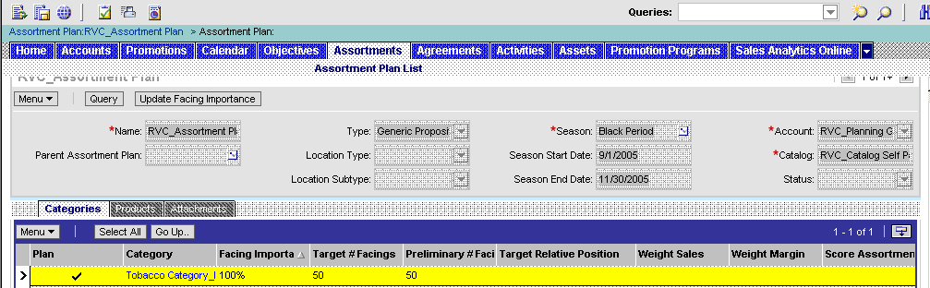
E.2. Develop assortment proposition
Define the assortment mix
Define the assortment mix of products
  Once the facing importance defined for each
  category and product, define the target number of
  facings for the highest level category and calculate
  the relative facing importance (Update Facing Importance button)
Calculate target facings and relative facing importance for all categories and products
Make sure the facing importance % have been filled out for all categories (100% for each level)
Go up to the 1st level Category (e.g. Tobacco Category)
Fill in the target # of facings for the total category (included all products of sub-categories)
Push the “Update Facing Importance” button
It recalculates the relative facing importance (vs. all products within all categories) and the Preliminary # Facings at each level (based on the one filled out in step 2)
3
1
2

Slide 37
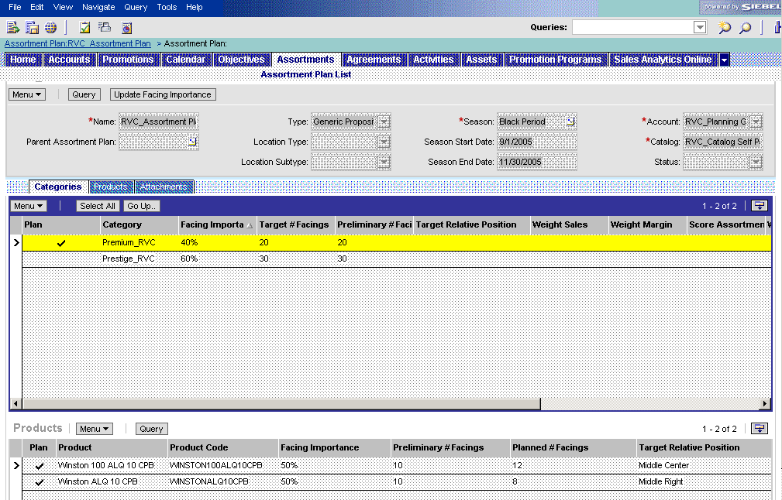
E.2. Develop assortment proposition
Define the assortment mix
Define the assortment mix of products
  Define the planned number of facings for all the
  products in the assortment
Define the final # facings for each product included in the assortment
Drill down to the lowest level of each category
In the “Products” applet on the bottom of the window, review the figures in the “Preliminary # Facings” (fields are populated by pushing the “Update Facing Importance” button)
In case you want to deviate from the proposed number, define the final number of facings in the “Planned # Facings” column
Fill out the Target Relative Position
-> These fields are copied to the Products view to provide a final overview
☺
1
2
3
4

Slide 38
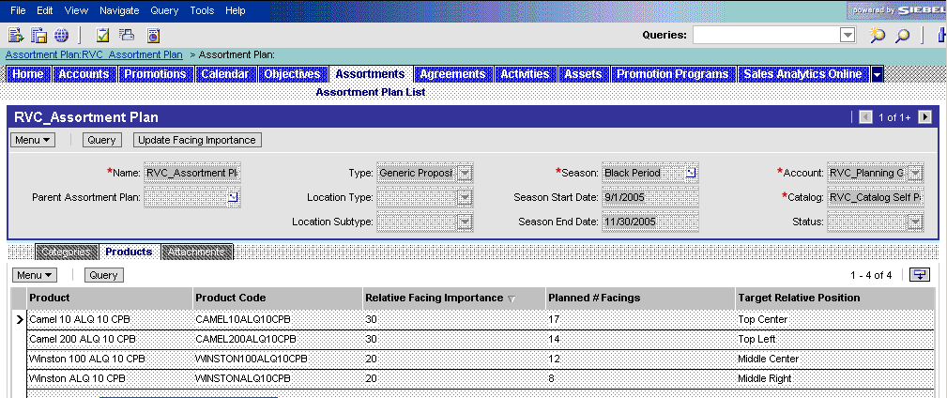
E.2. Develop assortment proposition
Review the assortment mix
Review the overall list of products of the assortment
  Navigate to the Assortment Products view &
  review all the relative facing importance, planned
  number of facings and the target relative position
  This view is read only, to make changes you need to go back to the “Categories” view
Review the final assortment proposition
Navigate to the “Products” view
Review all the relative facing importance, planned number of facings and the target relative position
In case you want to modify, go back to categories view and follow previously described steps
3
1
1
2

Slide 39
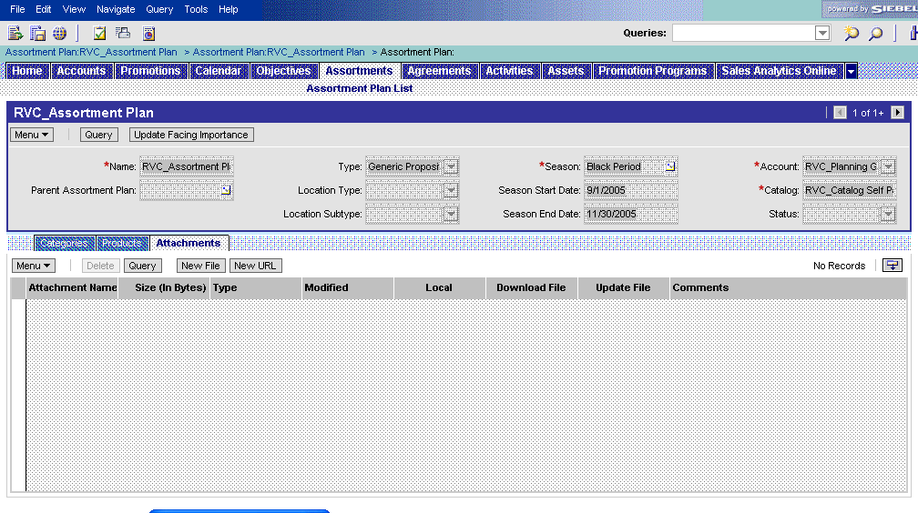
E.2. Develop assortment proposition
Add Assortment guidelines
Attach the Assortment Guidelines
  Navigate to the Attachments tab
  Attach the Guidelines document
1
2
Add supporting documentation for the assortment
Navigate to the Attachments view
Attach the Guidelines Document
Click on the “New File” button

Slide 40
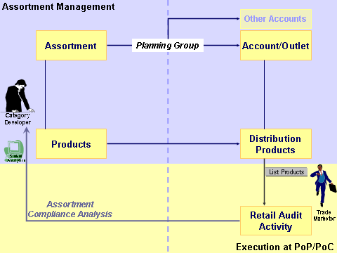
E.2. Develop assortment proposition
Principles of a child assortment
The Category Developer can specify the assortment
proposition for the merchandising locations (or secon-
dary locations) at the target outlets (planning group)
He/she will create first a generic assortment
proposition and following a child assortment and link it to the merchandising locations within the planning group.
  This illustration shows the creation
  and usage of a generic assortment
  proposition within the tool.
    The assortment plan and its
    products are allocated to the
    target accounts via the planning
    group
    The accounts‘ distribution list is
    updated accordingly
    The Trade Marketer executes a
    retail audit based on the
    updated distribution list (the active assortment)

Slide 41
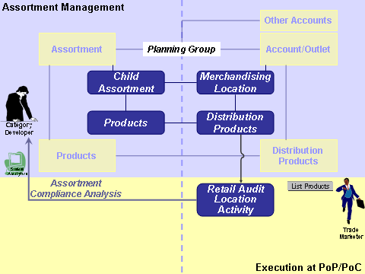
E.2. Develop assortment proposition
Principles of a child assortment
Once the generic assortment plan for the target
accounts has been defined, the Category Developer
creates child assortments to specify the assortment
proposition for the merchandising locations within
the outlets. He/she duplicates the assortment plan, and links it to the parent assortment plan, defines the type of target merchandising location and modifies the assortment mix & weights
  The creation and usage of a generic
  child assortment proposition.
    As the child assortment is linked
    to the origin assortment plan,
    the same planning group is
    applicable
    A new distribution list is created
    for the merchandising location(s)
    with the type defined in the
    child assortment
    The new distribution list is used
    during the merchandising
    location specific audit activity
* In the tool you need to select the same planning group as the parent assortment. The
final subset of targets is defined by the selected merchandising location type and subtype

Slide 42
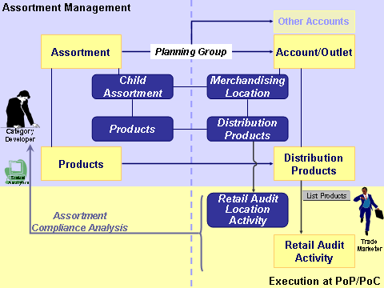
E.2. Develop assortment proposition
Principles of a child assortment
As the child assortment is a generic proposition that
deviates from the assortment for the entire account,
it is also limited in terms of target accounts and
products.
  The child assortment applies for the same planning group, but will only be used for the accounts
  which have the specific
  merchandising location at
  the outlet.
  The Catalog used for the
  child assortment is a
  duplicate of the Catalog
  used for the parent
  assortment. It should not
  have more products (less
  or equal) and can vary in
  weights (facing importance
  & target # of facings)
≤
≥
≤
* In the future the tool will be enhanced with an automated duplication of the catalog

Slide 43
E.2. Develop assortment proposition
Tool steps for creating a child assortment
To create a child assortment for an already existing
assortment plan, you need to execute following steps
in Siebel Sales
  Within Siebel Sales, each assortment proposition
  needs to be linked to a unique catalog. This also counts for a parent and
  child assortment plan.
  As by definition a child assortment is based on the same set of products, i.e. the same catalog, it is mandatory to first duplicate the catalog and then create a copy of the assortment and link it to the duplicated catalog.
Create a duplicate of the catalog linked to the parent assortment
Create a child assortment by copying the parent assortment
Define the target location type & catalog for the child assortment
Modify the assortment mix
Sales

Slide 44
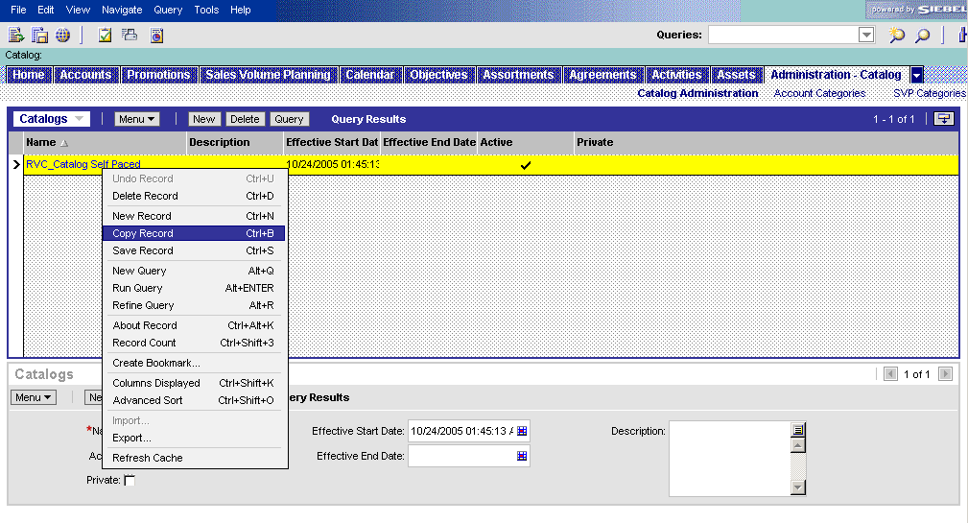
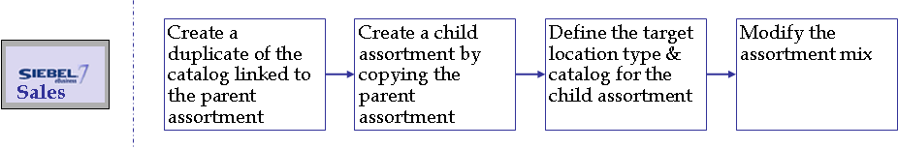
E.2. Develop assortment proposition
Duplicate a catalog
In the Catalog Administration view, you search the
catalog applied to the parent assortment plan and
you create a duplicate (copy record & rename)
1a
2
1b
3a
Duplicate a catalog
Open the view
  Go to SiteMap
  Navigate to the Administration – Catalog/Catalog Administration view
Search for the catalog applied to the parent assortment plan (Query button)
Duplicate the record
  Right-click with the mouse on the Catalog to copy in the list view
  In the pop-up menu, click on “Copy Record”
Fill in a new name for the catalog. Ensure that the name reveals that it is a copy of the original catalog and for which reason it was copied
(e.g. reference to the name of child assortment)
4
3b

Slide 45
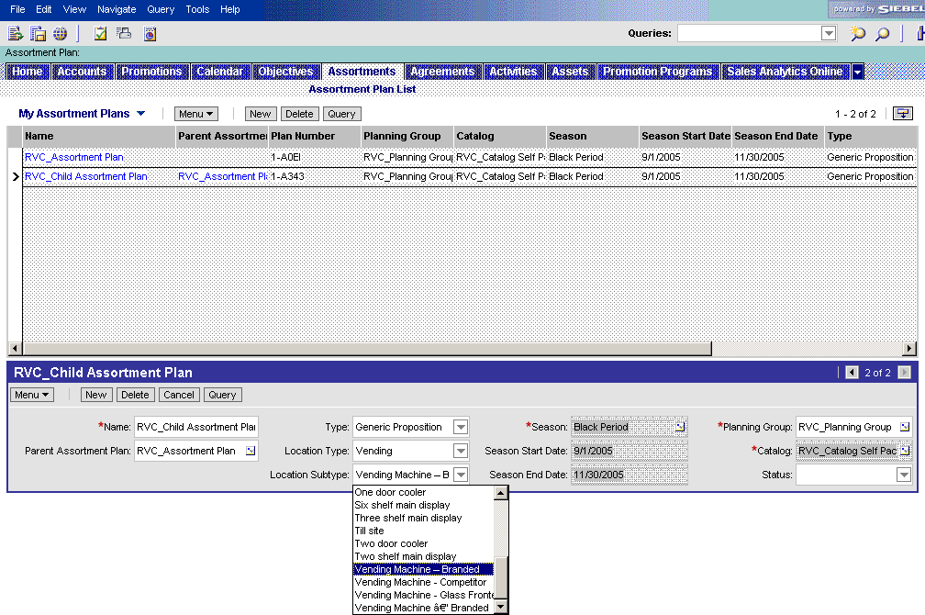
E.2. Develop assortment proposition
Create a child assortment
In the Assortment Plan List view, you search the
parent assortment for which you want to create a
generic child assortment and you duplicate the record
(copy record & rename). Then you link the duplicate
to the original “parent” assortment plan.
1
Create a child assortment
Navigate to the Assortment Plan List view
Search for the assortment plan for which you want to create a child assortment
Duplicate the assortment (similar procedure as duplication catalog -> copy record & rename new record)
Ensure that the name of the child assortment clarifies its relation with the parent assortment (e.g. Horeca-Mass segment Assortment – Vending)
Create the link with the parent assortment proposition by picking the name in the “Parent Assortment Plan” field
3
2
4

Slide 46
E.2. Develop assortment proposition
Detail the child assortment
The Planning Group should not be changed, nor the
type of the assortment, but the Catalog should! Define
the type of merchandising location you want to target
Define the catalog and the target location type of the child assortment
In the Catalog field select the catalog you created for the child assortment (duplicate of parent assortment)
Define the Location type and Location Subtype of the merchandising locations the child assortment should be applied to
This enables to see the right products in the “Products” view of the Merchandising Location and in the “Retail Audit Location activity”
2
1
A Child Assortment plan is still a Generic Proposition, but has a specific Location Type (specific target merchandising location within the outlets of the Planning Group)

Slide 47
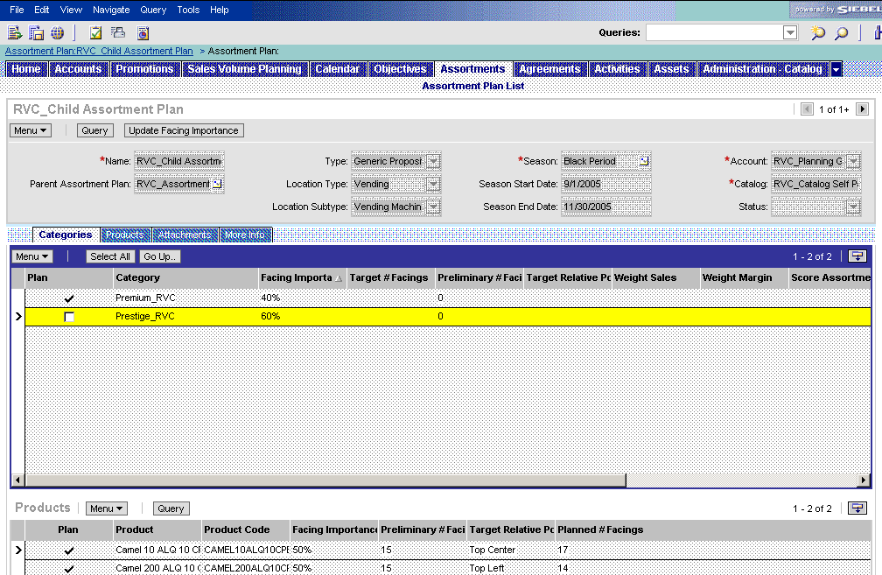
E.2. Develop assortment proposition
Modify the assortment mix of a child assortment
The child assortment should have an equal or
reduced product mix and should follow the guideline
in terms of Facing Importance and Target # Facings
4
Modify the product mix and weights for a child assortment
Drill down on the child assortment plan in the list view and navigate to the “Categories” view
In case you want to reduce the number of categories and products, uncheck in the “Plan” column the categories & products you want to exclude (e.g. specific focus for shelf versus vending machine within outlet)
Change the “Facing Importance %” and “Target # Facings” as described for the parent assortment plan (take into account the total target facings for the entire outlet)
Press the Update Facing Importance button
Change the “Planned # Facings” and the “Target Relative Position” in the products applet on the bottom of the screen (if required)
1
2
3
2
5

Slide 48
E.2. Develop assortment proposition
Communication to the accounts
Communication of the Assortment Proposition
  The sending of the Assortment Plan to all the
  accounts occurs automatically through the link with
  the Planning Group
  The retrieval and activation can be done
    Ad-Hoc: manually (= a button click “update assortment plan” -> script)
    Daily: automatically through an overnight procedure (no button click)
To send the assortment (or child assortment) to an additional account, you just need to add the account to the Planning Group (tool process described before)
To retrieve and active a new or modified assortment plan, you need to go to the Assortment Profile view in the Accounts screen and press for each account the „Update Assortment Plan“ button.
Update Assortment Plan
Assortment
Plan 1
Planning Group
  Account 1
  Account 2
  Account …
Account 1
Assortment Plan 1
Account 2
Assortment Plan 1
Account …
Assortment Plan 1

Slide 49
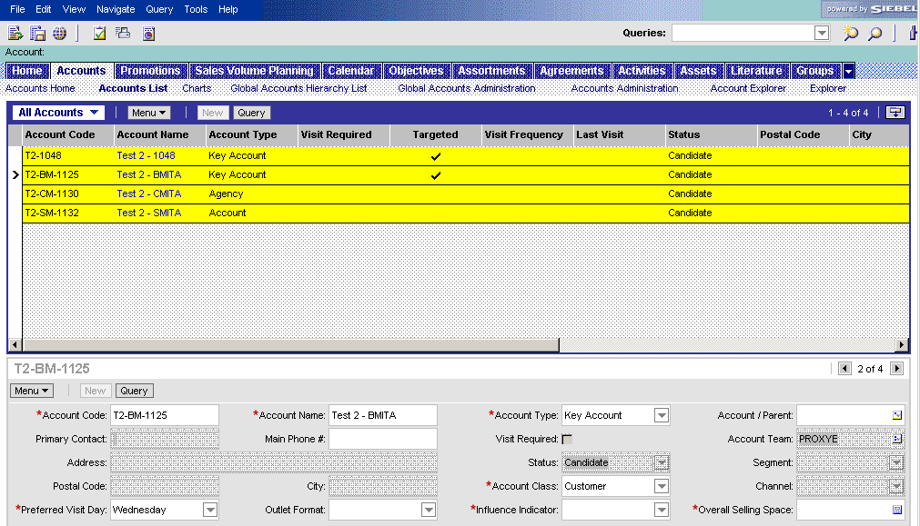
E.2. Develop assortment proposition
Activate the new assortment at account level
Activate the new or modified assortment plans and
check the deployment of the generic Assortment Plan
2b
1
2a
2c
☺
3
Activate assortment plans for all accounts in the planning group and check deployment
Navigate to the Accounts / Accounts List view (All Accounts)
Select all the accounts which belong to the Planning Group
  Use “Query” button OR
  Use the “Apply Target List” button and select the Target List on which the planning group was based (condition: accounts need to be equal in target list and planning group)
  Select all (ctrl+A or Menu button)
Drill down on any of the accounts within the selection
→ the detailed Accounts view opens

Slide 50
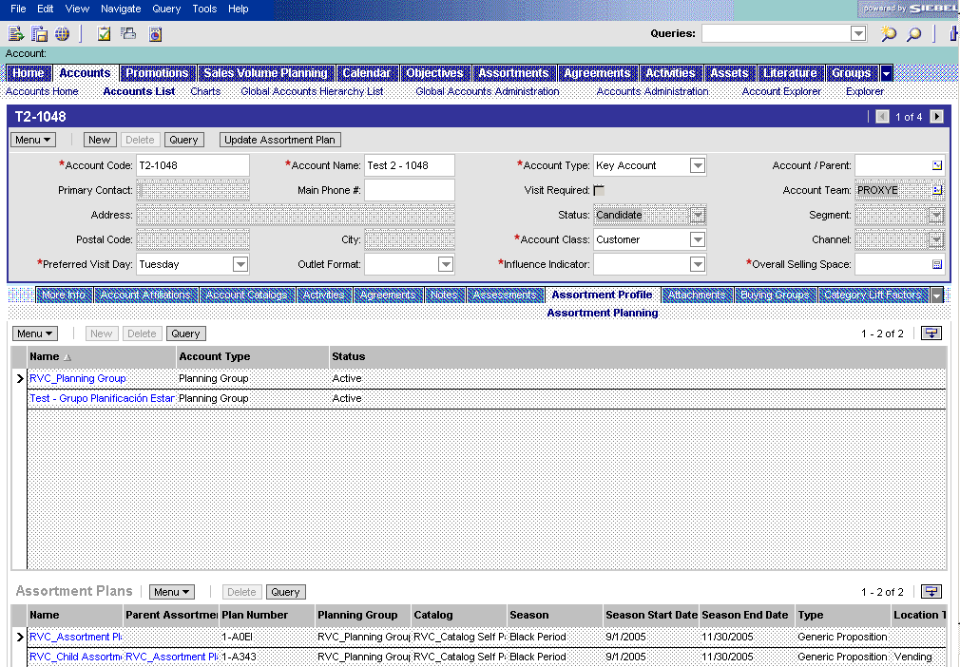
E.2. Develop assortment proposition
Activate the new assortment at account level
Activate the new or modified assortment plans and
check the deployment of the generic Assortment Plan
5
4
Activate assortment plans for all accounts in the planning group and check deployment
Go to the “Assortment Profile” view and validate presence of the Assortment Plan in the list applet on the bottom of the window. (The active status depends on the Season Start and End date)
Press the “Update Assortment Plan” button. This action is applicable to all accounts within the selection.
If you decide that the assortment plan should not be applicable to this account, drill down on the appropriate Planning Group and delete account in the “Groups” screen that opens.
☺
6
4

Slide 51
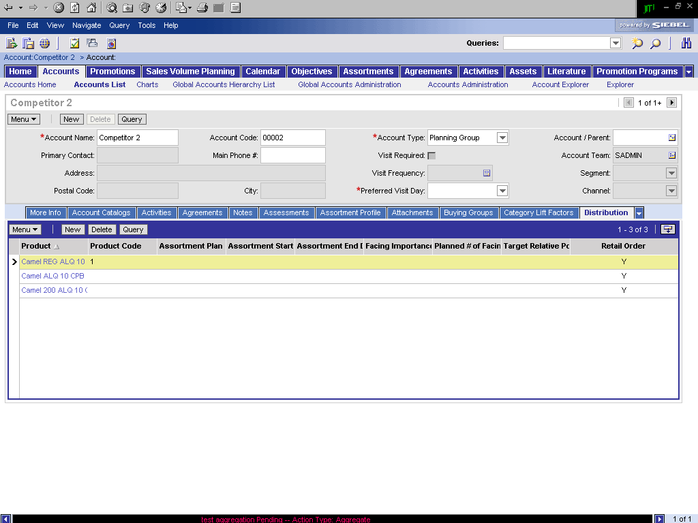
E.2. Develop assortment proposition
Validate good communication of assortment
Verify whether the new or modified Assortment
Plan has an impact on the Distribution list for the
account
Check impact on the distribution list
After you have selected the account (belonging to the Assortment’s planning group) and after you have pushed the “Update Assortment Plan” button (when opening the “Assortment Profile” view
Go to the “Distribution” view
Check whether all the products defined in the assortment plan are present in the distribution list
(the distribution list shows all the products of all the assortments applicable to the account, including child assortments for merchandising locations)
1
2
The Assortment will only be active if
  The current date is in-between the Season Start and the Season End date
  There is no Seasonal or Temporary Assortment ruling out the Generic Assortment
  AND
  You have pushed the “Update Assortment Plan” button

Slide 52
E.3. Customize assortment proposition
Principles of assortment customization
The Category Developer returns to the assortment
propositions and customizes the proposition for
  Strategic accounts (e.g. customize the Gas &
  Organized Convenience assortment for a Strategic
  Account within this channel)
  Temporary Deviations on Assortments: seasonal deviations or occasional events (e.g. summer at coast or music festival in the area)
The tool process for creating a customized assortment proposition is very similar to the creation of a child assortment.
In this case however, you can create a new planning group and you need to change the style of the assortment plan as it is no longer a generic proposition (temporary deviation, strategic account proposition, …)
Better Practice prescribes that you review the Siebel Analytics dashboards for Assortment Management to review consumer, customer and product trends and the assortment‘s performance before you customize the existing proposition

Slide 53
E.3. Customize assortment proposition
Tool Steps
The overall tool process to customize a generic
assortment proposition is the following
All the processes have been described previously, therefore following slides will only focus on the actual creation of a customized assortment
Analyze the reports in the “Review Input” dashboard
Analytics
Create a cluster and load as a target list
TIP: In case the planning group of the generic assortment is based on a cluster, you can open the cluster and refine the query and save it as a new cluster (e.g. specify an area or accounts belonging to a Strategic Account)
Marketing
Create a new planning group
Apply Target List in the Planning Group, and Commit selected outlets
TIP: In case the deviation of the assortment is applicable to the entire planning group of the generic assortment, you can reuse the same planning group and therefore you do not need to execute this step (create new Planning Group)
Sales
Create a duplicate of the catalog (used for the generic assortment plan)
Create a duplicate of the generic assortment
Link the assortment plan to the new catalog and planning group
Modify the assortment mix
Review the products, their required # of facings and location

Slide 54
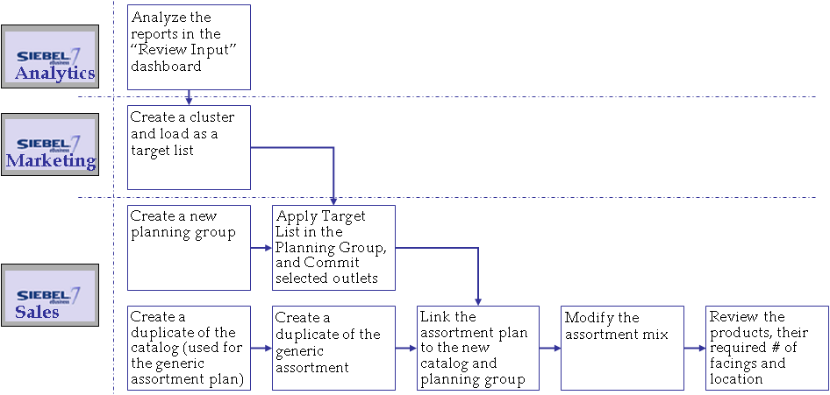
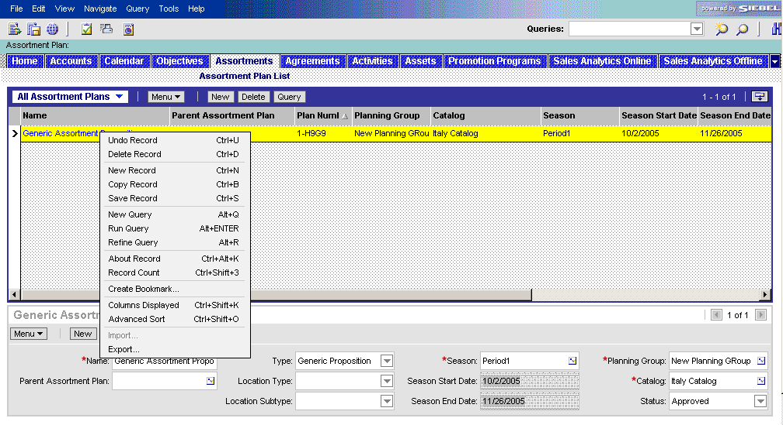
E.3. Customize assortment proposition
Duplicating a generic assortment
Duplicate the Generic Assortment (process E.2.)
1
2
Duplicate an assortment plan
Navigate to the Assortments screen
In the list of Assortment Proposition, select the one to be customized
In the Menu button (or by a right click), select the ‘Copy Record’ function
Enter a name for the Customized Assortment Proposition
3
4

Slide 55
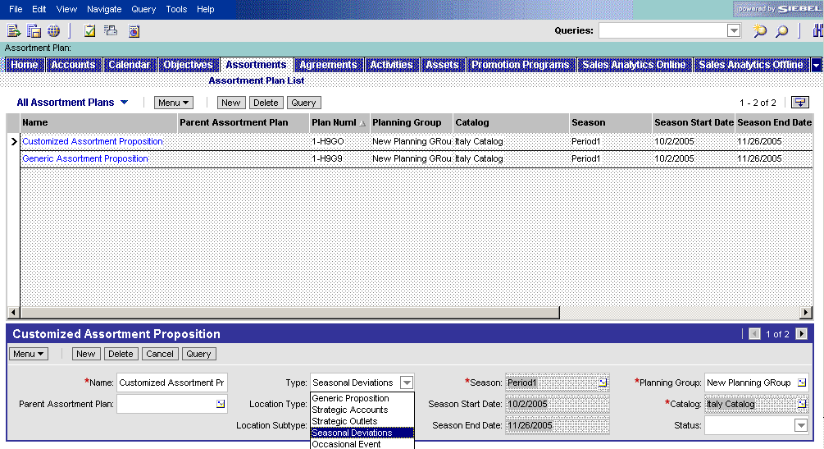
E.3. Customize assortment proposition
Detail the customized assortment
Provide the main characteristics: Type of assortment,
Planning Group (or Strategic Outlet) and Catalog
Define the main characteristics of the customized assortment
Define the type of deviation for which have to customize the generic assortment (Strategic Account, Strategic Outlet, Seasonal Deviation or Occasional Event)
Pick the Planning Group you created for this customized assortment (or Strategic Outlet)
Pick the Catalog you duplicated in a previous step
1
2
3

Slide 56
E.4. Execute
Principles and Tool Steps
Once the Category Developer and the Operational
Planner agree on the final assortment propositions
(generic or specific), the latter will start to create and
plan the activities to implement the propositions on
the field. The Trade Marketer will execute.
Such activities may be
  Negotiate new assortment proposition with customer
  Perform an audit to check compliance with the new assortment (2 types)
    Retail Audit: Trade Marketer checks compliance of the Assortment at the PoS
    Retail Audit Location: Trade Marketer checks compliance of the Assortment for each Merchandising Location at the PoS
How to execute such retail audit activities is explained in detail in the „Execution at PoP/PoC“ module. In general the tool process is as follows:
Login as a Trade Marketer
Open a visit with a retail audit activity
Execute the retail audit at the PoS
Sales

Slide 57
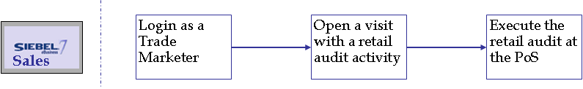
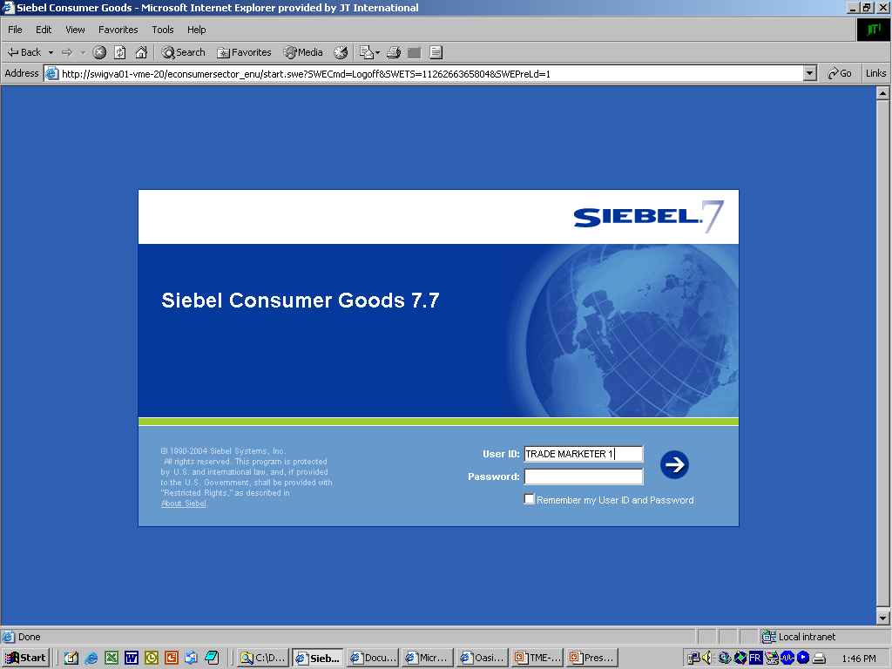
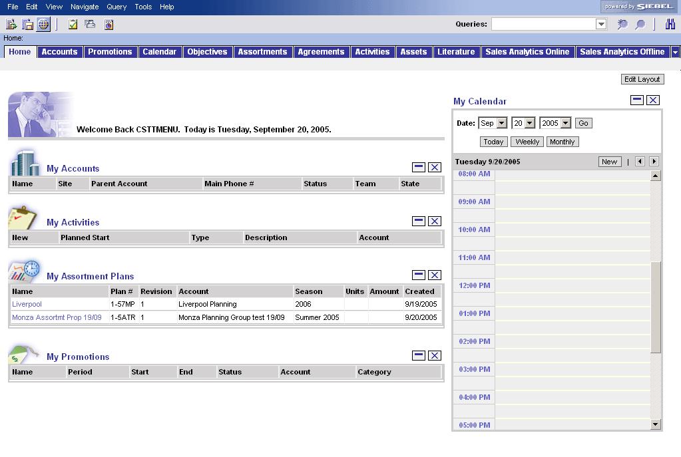
E.4. Execute
The Trade Marketer’s home page
To the home screen of the Trade Marketer
How a Trade Marketer accesses his visits
Login as a Trade Marketer (the Home Screen pops up)
There are a few options to Start a Visit:
  Click on My Accounts, select the Account and click on the tab Outlet Visits (one visit)
  Click on My Visits, select a visit
  Go through the calendar (click on the visit in the calendar)
  Go to the Screen “Visits “(all Visits)
1
2d
2c
2a
2b

Slide 58
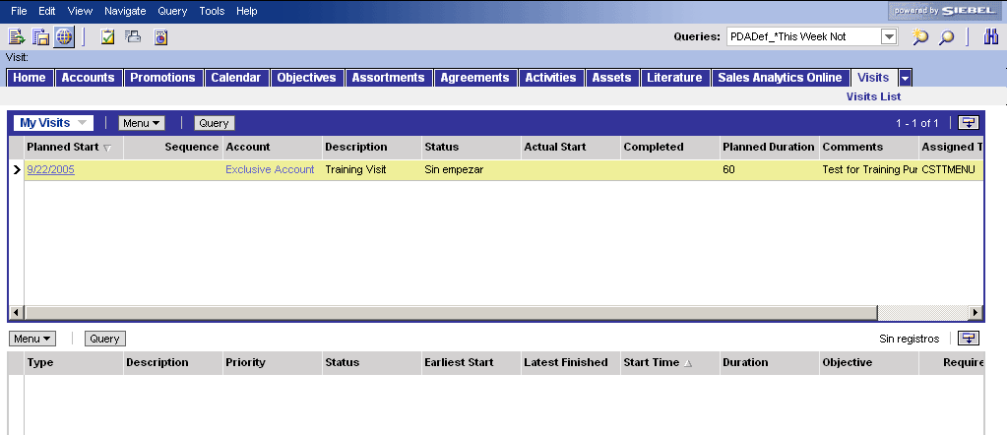
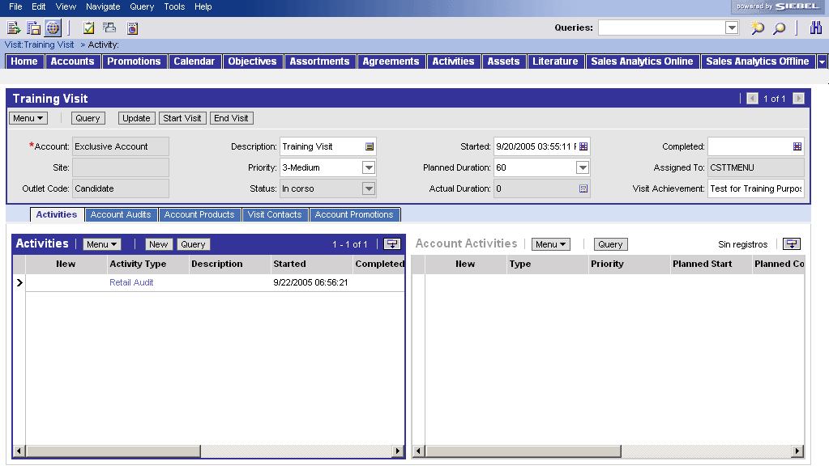
E.4. Execute
Open and review details of the visit
Review details of the visit and the retail
audit
1
2
3
Visit details (account / activity)
Click on the Visits tab
Select your visit (use Planned Start column). Drill down on specific visit
Check which account you have to do the retail audit for

Slide 59
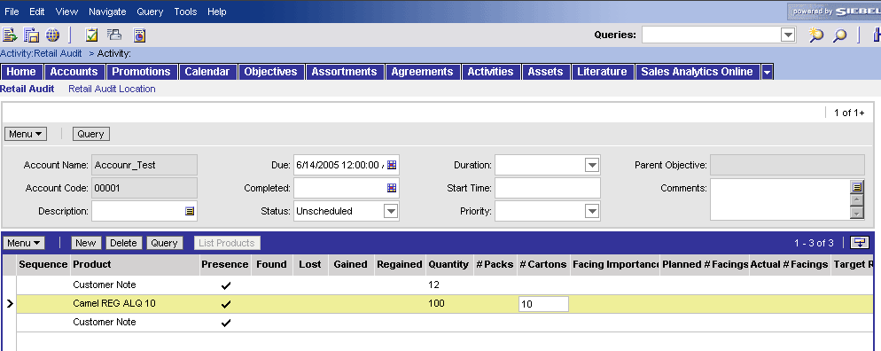
E.4. Execute
Execute a retail audit activity
Start visit and execute retail audit activity
(or retail audit location activity)
1
7
2
Execute the retail audit
Start the visit
Go to the Activities view
Drilldown in the Retail Audit activity
Refresh the list of products with button ‘List Products’ (the list will copy the products from the distribution list = planned products)
For each product, check for
  Presence
  Quantity
  Facing
→ this will reflect the Actual Assortment at the outlet
Add new products in case the product is in the outlet but not in the distribution list (it will be saved in the retail audit, not in the distribution list)
End visit when the activities are finalized
3
Retail Audit for a Merchandising location
6
4
5

Slide 60
E.5. Measure and Evaluate
Tool support
The Category Developer measures the effectiveness of
the assortment by looking at the impact on sales,
penetration and Brand awareness.
(e.g. sales volume, sales volume per targeted
consumer, SOM, stock turn, margins, profit contribution, visibility index, consumer service level,…) and on supply chain (e.g. ease of replenishment, average order quantity).
Siebel Analytics provides 2 dashboards to support this analysis
  “Execute in PoP/PoC” : to measure the correct implementation and execution of the assortment and its related activities
  “Evaluate assortment” : to measure the actual compliance of the assortment within an outlet, region, segment, market

Slide 61

E.5. Measure and Evaluate
Dashboard – Execute in PoP/PoC
Measure the actual implementation of the
assortment
1
2
3
4
Analyze the assortment implementation status
Select values for the query
Select the assortment that you want to analyze
Define the time period
Click GO

Slide 62

E.5. Measure and Evaluate
Dashboard – Evaluate assortment
Measure compliance rates of the assortment
1
2
3
4
Measure compliance of the assortment
Select values for the query
Select the assortment that you want to analyze
Define the time period
Click GO

Slide 63
Table of contents
Introduction to Better Practices for Assortment Management
  Definition
  Process Overview
  Capability Interdependencies
Tool support for Assortment Management processes
  JTI versus Siebel Terms
  Tool support
  Tool step overview by BP process
  Tool steps in detail
Demo & Exercises
  Tool demo
  Exercises

Slide 64
Assortment Management
Live demo in Siebel Applications
Story Line
  In Italy, the Grand Prix is taking place in Monza in September 2005. JTI is sponsoring F1 racing through several brands in different teams. Special trade marketing actions have been identified for the non-strategic outlets in the 10 km geographic area around Monza.
  A large increase in sales is expected. The Category Manager is setting up a cluster with temporary deviation to meet the assortment needs.

Slide 65
Assortment Management
Live demo in Siebel Applications
Demo (1/3)
  Insight (from the Category Developer role)
    A cluster will be created in Insight using the Marketing Segmentation Manager module.
    This cluster is transferred into Laptop as a Target List of outlets.
  Laptop (from the Category Developer role): create the planning group
    Select Groups screen (site map).
    Create a planning group.
    Drilldown from ‘Planning Group Name’ field to Planning Group Accounts view.
    Search for the Target List created in Insight.
    Add the outlets by applying this Target List.

Slide 66
Assortment Management
Live demo in Siebel Applications
Demo (2/3)
  Laptop (from the Category Developer role): create the assortment plan
    Select Assortments screen.
    Create an assortment plan for the Monza Grand Prix event.
    Drilldown from assortment plan name field to Assortments/ Categories view. Select mix of sub-categories: enter weights.
    Drilldown from ‘Category’ field to the next level. Select mix of products segments: enter weights.
    Drilldown to the next level. Select mix: enter weights.
    Click on Go Up button to return to the sub-category level.
    Click on Attachments view tab, attach the Assortment Guidelines document.
  Laptop: Communicate the assortment proposition
    In the assortment screen, the apply button will enable the distribution of all the products of the assortment to the corresponding outlets.
    View the Products by Account within the Assortment
      Select Accounts screen. Drilldown from account name field to Account/Activities view.
      Click on Assortment Profile view tab to view the assortment propositions linked to the outlet.
      Drilldown from assortment name field to Assortments/ Categories view.
      Use thread to return to Accounts/Assortment Profile view.

Slide 67
Assortment Management
Live demo in Siebel Applications
Demo (3/3)
  Communicate the assortment proposition
    In the assortment screen, the apply button will enable the distribution of all the products of the assortment to the corresponding outlets.
    View the Products by Account within the Assortment
      Select Accounts screen. Drilldown from account name field to Account/Activities view.
      Click on Assortment Profile view tab to view the assortment propositions linked to the outlet.
      Drilldown from assortment name field to Assortments/ Categories view.
      Use thread to return to Accounts/Assortment Profile view.
  Execution (from the Trade Marketer role)
    Go to the Accounts screen.
    Search for the outlet that the TM is visiting. Drill down on the outlet name.
    Click on Distribution view tab to view list of products linked to the outlet.
    Click on Activities view tab.
    Create new activity with type = Retail Audit.
    Drilldown from activity type field to Retail Activity detailed view.
    Click on List Products button to display the agreed assortment and to register the actual assortment.
    Execute the retail audit by clicking the products which are out of stock.

Slide 68
Table of contents
Introduction to Better Practices for Assortment Management
  Definition
  Process Overview
  Capability Interdependencies
Tool support for Assortment Management processes
  JTI versus Siebel Terms
  Tool support
  Tool step overview by BP process
  Tool steps in detail
Demo & Exercises
  Tool demo
  Exercises

Slide 69
Tool exercises for Assortment Management
#1: Create a generic assortment proposition
Log on to the Siebel Application
  Use the following Login details:
    User ID: CSTCMESN or CSTCMITA
    Password: CSTCMESN or CSTCMITA
    Connect to: http://tme-uat.jti.com/econsumersector_enu
Create Assortment
  Define Planning Group
    Go to the Groups screen, Create a Planning Group
      Planning Group Name: Night clubs Planning Group
      Status: Active
    Drilldown and add Accounts to the Planning Group
  Go to the Assortments screen
    Create an Assortment Proposition
      Name: Night Clubs AP
      Season: 2006
      Account: Night clubs Planning Group
      Catalog: Night clubs Assortment
      Type: Generic Proposition

Slide 70
Tool exercises for Assortment Management
#2: Define the assortment mix
Define the Categories within this Assortment Proposition
  Define the mix mix of Sub-Categories and assign facing importance
    Define the mix of Sub-Categories and assign facing importance
      (Cigarettes) <flag> Facing Importance= 100
      (Cigars) <no flag>
      (RYO / MYO): <no flag>
      (Pipe Tobacco): <no flag>
    Define the mix of Product-Segments and assign facing importance
      (Prestige) <flag> Facing Importance= 30
      (Premium) <flag> Facing Importance=70
      (Sub-Premium) <no flag>
    Define the mix of Products and assign facing importance
      (Camel FF 20) <flag> Facing Importance= 40
      (Camel LT 20) <flag> Facing Importance= 60
      (Winston LT 20) <flag> Facing Importance= 50
      (Winston LT 20) <flag> Facing Importance= 50
    Calculate the relative facing importance for each product: Push the 'Update Facing Importance' button and check results

Slide 71
Tool exercises for Assortment Management
#3: Update an assortment at outlet level
Update Active Assortment Plans
  Define scope of Outlets for which you want to update the active Assortment Plan
    Go to the Accounts screen
    Go to the Account Lists view
    Apply the 'Night Clubs' target list
  Set the correct Assortment Plan active for all outlets
    Go to the Assortment Profile view of one of the outlets
    Push the 'Update Assortment Plan' button
  Check Assortment Plan for specific outlet
    Go to the Account List view
    Select an outlet that is part of the 'Night Clubs' cluster
    Go to the Assortment Profile view for this outlet
    Check to which Assortment cluster this outlet belongs
    Check which Assortment Plan is active
    Drill down on the Name of the active Assortment plan to the view where you can check the content of the assortment plan
    Check which Products are included in the active Assortment Plan
    Go to the Distribution view of the outlet for which you checked the active Assortment Plan
    Check if the list of products in the Distribution view is consistent with the list of products in the active Assortment Plan (a product is active if the 'Facing Importance' field is populated)

Slide 72
Summary : Learning objectives of this module
You are now able to
  Understand how the TME applications support the BP processes for Assortment Management
  Create Clusters in Siebel Marketing and use them in Siebel Sales CG
  Create generic and specific Assortment Propositions in Siebel Sales CG
  Review Assortment data in Siebel Analytics
Notes:
Review key objectives as documented on the slide with your participants.
The Better Practices based on the 10 capabilities will require New ways of working and the IT systems and tools will support and enable them!

Slide 73
Next steps after the training session
Based on what you have learned, your next steps are
  Familiarize with the Siebel applications
  Execute the Self-Paced exercises available on the TME University Portal
  Localize training material
  Train other users in your market
  Attend more upcoming intermediate and advanced trainings to complete your knowledge of Assortment Management

